Slide 1
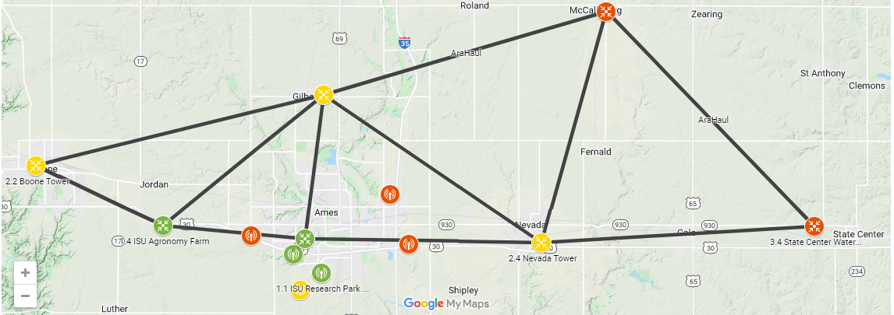
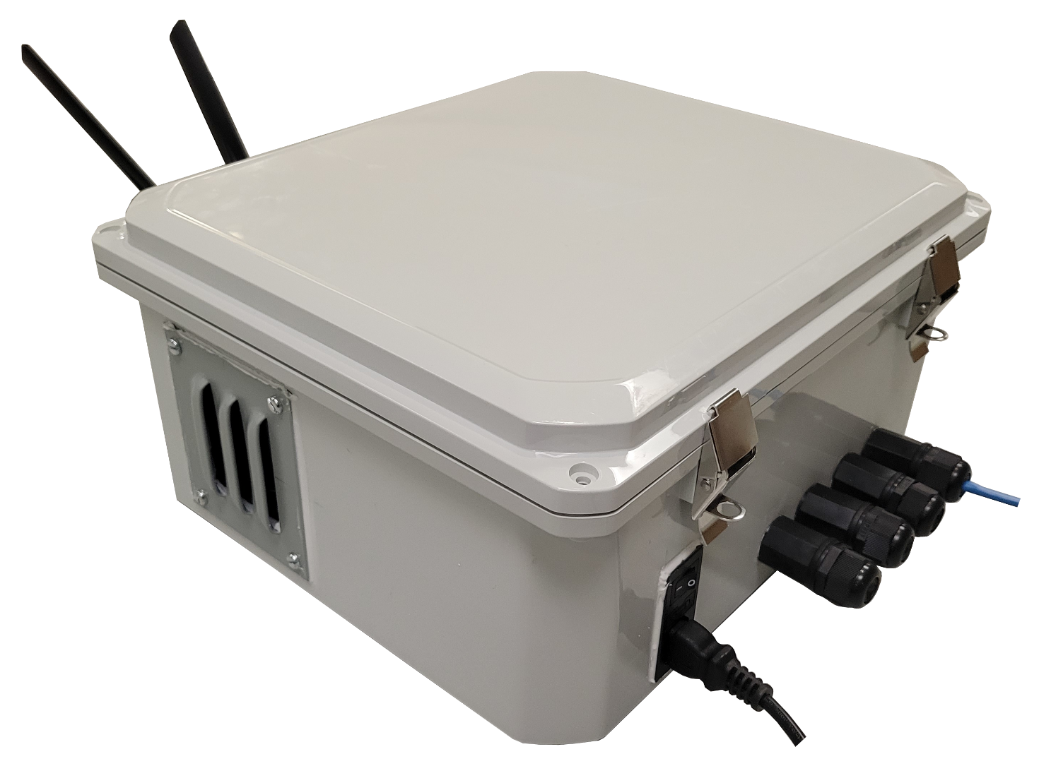
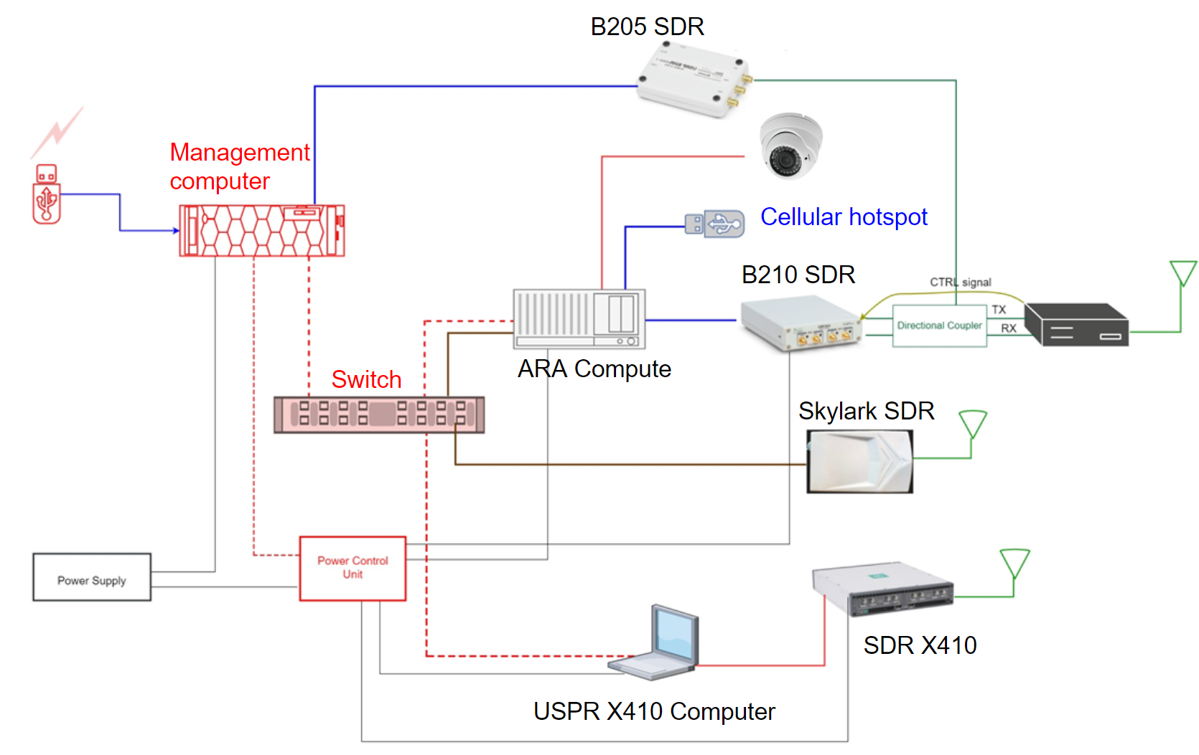
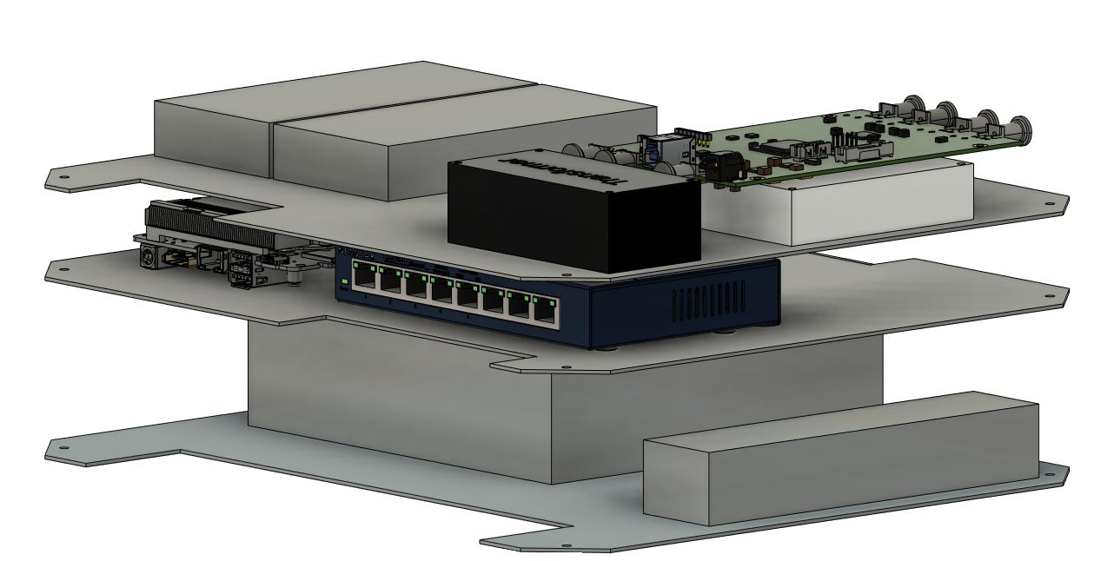
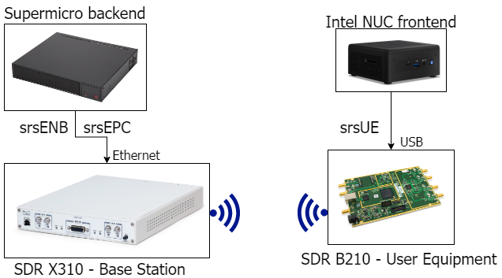
Sdmay22-30: 5G and Beyond Prototyping
Client/Advisor: Hongwei Zhang
Team Members: Josh Guyer, Josh Naber, Johnathan Leisinger, Nick Garrelts, Connor Kesterson, Raffael Neuser, Ruofeng Gao
Website: https://sdmay22-30.sd.ece.iastate.edu/docs.html
Problem
ARA- Agriculture and rural communities
Provide an experimental infrastructure for wireless applications
Rural wireless broadband for agricultural uses
Need a way to deploy all this equipment in an easy manner to many different users
Solution should be generalized so it can fit many use cases
Solution
Create an enclosure to store the necessary components
Simplify manufacturing process of the enclosure
Experiment with software to increase performance metrics of software defined radios
Design Requirements
Functional:
Enclosure should have ethernet ports and be waterproof
All components should fit inside the enclosure
Algorithms should perform better than default
Nonfunctional:
Enclosure should be portable
Enclosure should be easy to manufacture
Easy to deploy
Algorithms should work as designed
Constraints:
Completed in two semesters
Operating Environment:
Multiple outdoor deployments across Iowa
Standards:
IEEE 802- networking standard
IEEE 1914.1- radio protocol standard
Intended Users and Uses
Users
Universities
Farmers
Rural communities
The city of Ames
Uses
Provide connectivity for wireless networks
Cloud computing
Plant phenotyping
Remote monitoring
Tele-operation of agricultural vehicles
Design Approach
Enclosure design:
CAD 3D design model
3D printing prototype
DPH-28712 enclosure design (pictured right)
Cut acrylic panels with waterjet for mounting hardware
Software design:
Researching SDR algorithms
Creating a testbed
Running implementation of algorithms
Technical Details
Hardware (pictured left):
Components in the UE
B210 SDR
Skylark mMIMO SDR
B205 SDR
8 port network switch
LN amplifier
Management and compute computer
Software (pictured bottom left):
srsRAN source code
Algorithm Implemented in srsUE
Implemented Unified Cellular Scheduler (UCS) algorithms
local-deadline partition (LDP) algorithms
Weighted Fair Queuing(WFQ) algorithms
Device-to-Device (D2D) algorithms
Testing
Hardware:
Run script on management computer to start srsRAN
Attach camera via ethernet ports on enclosure
Use srsRAN to connect to base station
Transfer camera data to base station
Verify you can see camera feed on base station
Software:
Testbed with server and client systems
Running test scripts
Project Resources
ARA Partners:
Partners at universities (Kansas State, Ohio State, …)
Industries (Mediacom, John Deere, …)
Communities (NSF, FFA, …)
Government agencies (NIFA, City of Ames, …)
All of these entities want to address the challenge of rural broadband internet.

